Slide 1
United States Marine Corps
Inspector General
Intelligence Oversight
Mr. Edwin T. Vogt
Director
Intelligence Oversight Division

Slide 2
BRIEFING TOPICS
MISSION AND ORGANIZATION
INTELLIGENCE OVERSIGHT TRENDS
REPORTING AND ISSUE RESOLUTION
PROGRAM ASSESSMENT

Slide 3
Oversight Division
Oversight of intelligence and non-intelligence “Sensitive Activities”
Includes: Intelligence, counterintelligence, covered/clandestine actions, special access programs, support to law enforcement agencies, special operations, special activities

Slide 4
Sensitive Activities
Sensitive Activities are activities, by their very nature, that require special oversight to reduce the potential for:
  Physical risk to DON personnel or property
  Issues of unlawful/improper conduct
  Public embarrassment
May require special protection from disclosure
Notes:
Sensitive Activities:
If not properly executed or administered, could raise issues of:
Unlawful conduct;
Government ethics;
Unusual danger;
May require special protection from disclosure

Slide 5
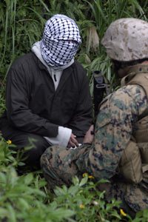
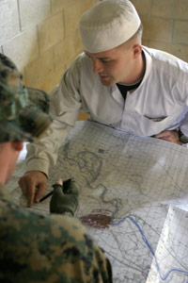
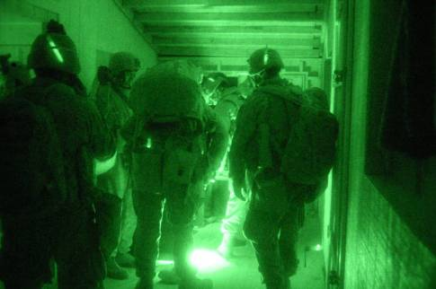
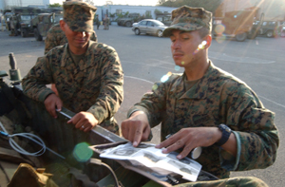
ISSUES ASSIGNED TO IGMC-IO
CLASSIFIED
ACTIVITIES
INTELLIGENCE
ACTIVITIES

Slide 6
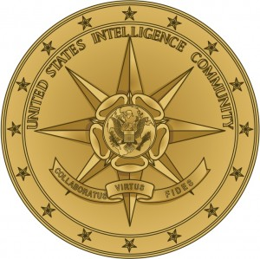
Why Intelligence Oversight
Intel Oversight Laws, Executive Orders, & Regulations
1960/70’S
Vietnam/Civil Rights era
abuses:
Infiltration of college campuses and domestic orgs
Involvement in domestic political issues
Surveillance of war protestors
Notes:
You have to understand where we came from, in order to understand why we are here. The Founding Fathers distrusted large standing armies and cherished individual liberties. Americans have a long tradition of distrusting government. It is upon this tradition that the requirements of Intelligence Oversight are laid. Abuses of power by the Intelligence Community during the 1960’s and 1970’s, exposed by the Church and Pike Congressional committees, led to tighter controls on Intelligence activities.

Slide 7
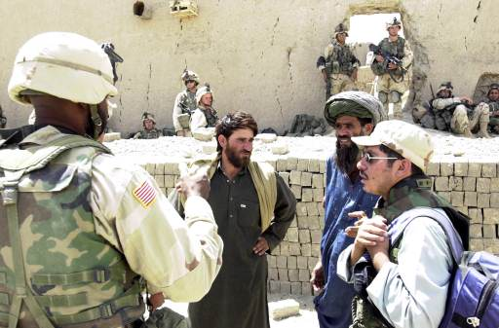

WHY INTELLIGENCE OVERSIGHT?
Relevance in the Current Environment
GWOT AND
TRANSFORMATION
FORCE PROTECTION
EVOLVING
CAPABILITIES
PRE-DEPLOYMENT TRAINING
&
COMMAND RESPONSIBILITIES
INFORMATION SHARING
&
INTELLIGENCE FUSION
OPEN
SOURCE
COLLECTION

Slide 8
EXAMPLES OF
SENSITIVE ACTIVITIES
    Lethal support/training to Non-USMC/DoD agencies
    Use of Marines in law enforcement undercover ops
    Loan of gear/training support to civilian law enforcement agencies
    “Covered/clandestine” activities CONUS/OCONUS
    CONUS off-base urban training
    Intelligence collection of info on U.S. persons
    Special Access Programs (SAPs)
    Support/agreements to certain Govt (DoS, CIA) or non-Govt agencies
Notes:
Example of Inspector’s questions for off-base urban training:
1. Has coordination been made with the SJA?
2. At what command level has this training been approved?
3. Has coordination been made with effected LEAs? local, county, state, FBI? Specific names/who?
4. What safety precautions are in place?
5. Has an Operational Risk Management (ORM) been conducted?
6. What type of training/briefings has been effected? e.g. Intel Oversight, Contact with the Public, De-escalation of force/situations
Is PAO involved? Do they have a PA plan?
Compare MARADMIN 472/02

Slide 9
WHY INTELLIGENCE OVERSIGHT?
Relevance in the Current Environment
PROTECT USMC INTERESTS
PROTECT CONSTITUTIONAL RIGHTS
PERFORM INTELLIGENCE ACTIVITIES LAWFULLY
REPORT QUESTIONABLE ACTIVITIES

Slide 10
IGMC Relationships
(within the Department of the Navy)
The Honorable Carlos del Toro
Secretary of the Navy
General David H. Berger
Commandant of the Marine Corps
Vice Admiral John Fuller
Naval Inspector General
Commanding
Generals
Inspector General of the Marine Corps
(DEPUTY NAVAL IG FOR MARINE CORPS MATTERS)
Command
Inspectors General
Notes:
Congress created the Office of the Secretary of the Navy and assigned to it sole responsibility for the Inspector General function. 10 USC 5014
Congress created and detailed the statutory duties of the Naval Inspector General. 10 USC 5020
Only the Deputy Naval Inspector General for Marine Corps Matters performs the naval inspector general functions for the Marine Corps.
The NAVINSGEN and the IGMC each reports to the Secretary or Under Secretary separately:
each employs practices and procedures most suited to its Service
coordinate on policy issues when appropriate
operate in separate locations
Authority “flows” from the Secretary of the Navy, through the Naval Inspector General to the Marine Corps Inspector General
Complete title: Deputy Naval Inspector General for Marine Corps Matters/Inspector General of the Marine Corps
Authority from the Secretary of the Navy used to comply with direction provided by CMC
Inspectors in the fleet respond directly to the IG on Inspector issues. Inspectors are guided and tasked as required by the IG of the Marine Corps

Slide 11
IGMC Organization
Inspector General
of the Marine Corps
Deputy
Inspector General
Sergeant Major
Chief of Staff
Inspector General
Counsel to the
Inspector General
Administrative
Support Division
(CWO4)
Inspections Division
(Col/O6)
Senior Official
Investigation Division
(GS-15)
Analysis/Evaluation
Division
(Col/O6)
Intelligence
Oversight
(GS-15)
Assistance & Hotline
Division
(GS-15)
Notes:
No brief is complete without an organizational chart.
The IG has 6 major divisions and a Counsel who works for SecNav but is assigned to the IGMC.
Depending on the case/circumstances, IGMC reports directly to SecNav or CMC.
Our overall staff is 27 people; Both the Admin Division and IGMC Counsel are worth their weight in gold. The first keeps everything coordinated, inbound correspondence (FOIA) related, assists, security management, personnel support, everything behind the scenes… they do). By virtue of what they do on the investigation side of the house, having an in-house counsel pays dividends for not only the CG but our investigators early in the investigation process. Helps shape allegations and whether we like it or not, special interest, SOI, whistleblower cases cannot be forwarded from our office without a formal thumbs up from Counsel on legal.

Slide 12
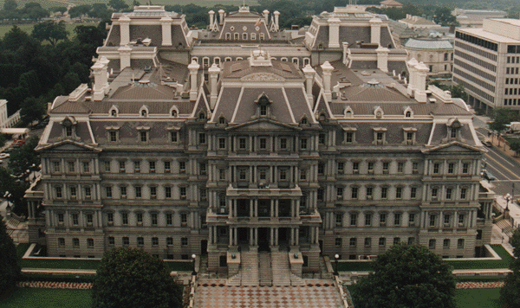
Intelligence Oversight
Presidential Charter
INTELLIGENCE OVERSIGHT BOARD
SECDEF
QUARTERLY
REPORT
Department of Defense
General Counsel
SIOO
POLICY AND
GUIDANCE
COMPLIANCE
INSPECTIONS
Notes:
To ensure that these orders are complied with, a structure of oversight and reporting was set up. The President’s Intelligence Oversight Board was created. Quarterly, every Service must report in the affirmative of:
Our compliance regarding the requirements of the various orders and regulations
Any questionable activities
Any issues relating to Intelligence Oversight
So if you ever wondered where your Quarterly Intelligence Oversight report went, or if any one actually read it, now you know.

Slide 13
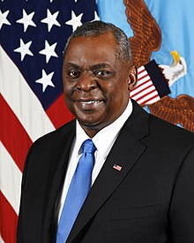
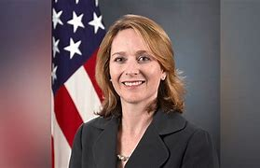
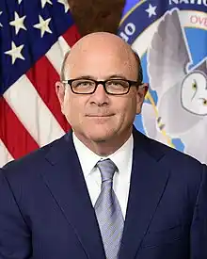
SECDEF
Lloyd J Austin III
Deputy
Secretary of Defense
Kathleen Hicks
DOD IG
Robert Storch
ATSD-CLPT
Mark Dupont
General
Counsel
ASD
(Legislative
Affairs)
ASD
(Public Affairs)
Director
Administration
and Management
USD
(Intelligence)
USD
(Policy)
USD
(Comptroller)
USD
(Personnel &
Readiness)
Director
Operational Test
& Evaluation
USD
(Acquisition
Technology
and Logistics)
RESPONSIBLE FOR THE OVERSIGHT OF
ALL INTELLIGENCE / COUNTER INTEL ACTIVITIES
IN THE DEPARTMENT OF DEFENSE

Slide 14
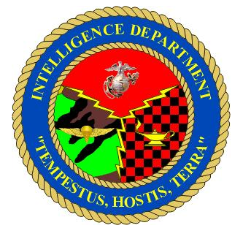
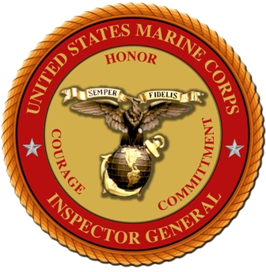


Intelligence Oversight Triangle
Commanders Remain Responsible for
Everything the Unit Does or Fails to Do
Intelligence Professional
Inspector General
of the Marine Corps
A system of checks and balances to mitigate risk

Slide 15
Trends
What We Are Seeing in DoD
Inspections
  Execution of Intelligence Activities is Generally Good
  Troops Get Trained—Leaders and Contractors Don’t
  Unimaginative Training Leads to Poor Retention
  Lack of Non-Intel Leader Awareness and Emphasis on IO
  Loss of High Demand Low Density Personnel to the Private Sector
Reports of Questionable Intelligence Activity (Procedure 15)
  Conduct of Intelligence Activities without Appropriate Authority
  Personnel Misconduct in the Course of Intelligence Operations
  Failure to Report Questionable Activities

Slide 16
IO Reporting
Requirements & Resolution
Reporting is Non-Negotiable
Report All Questionable Activity
    Confirmed and Possible Violations
Report To Intel Oversight Within 5 Working Days of Discovery
    MARFOR, IGMC, SJA, Command Channels or VFR Direct

Slide 17
USMC Procedure 15
Reporting Chain
OSD
ATSD-IO
IGMC (IO)
OGC
IO Chain
5 days to report
IGMC (GC)
SJA (C)
MARFOR
SJA
Intelligence
Component
UNIT
IG

Slide 18
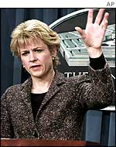
One Last Point On Reporting
Questionable Intelligence Activities
“In the information age, the bad news is going to get out…the only question is who will tell it first and will they tell it accurately.”
- Torie Clark
Former Asst. SECDEF for Public Affairs

Slide 19
INTELLIGENCE OVERSIGHT
Getting Started with Your Units
Do your homework and read the regulations.
Identify subordinate Intel units and/or activities.
Get your Staff Judge Advocate involved.
Inspect as part of the CGIP:
    Training program in place
    Understanding of appropriate activities
    Knowledge of reporting requirements

Slide 20
GOOD IO PROGRAM COMPONENTS
INSIGHT
OVERSIGHT
FORESIGHT

Slide 21
COMPONENT BREAKDOWN
INSIGHT- Knowledge of programs and potential pitfalls
OVERSIGHT – Review of programs for compliance with current laws and directives
FORESIGHT – Determine way ahead to mitigate future problems and set path for future lawful conduct

Slide 22
GOOD INTELLIGENCE OVERSIGHT PROGRAM INDICATORS
COMMAND AND LEADER EMPHASIS
CODIFY RESPONSIBILITIES AND REQUIREMENTS
FORMALLY APPOINT IO OFFICIAL (Whom Everyone Knows)
TRAINING – EARLY AND OFTEN – WITH CREATIVE REINFORCEMENT

Slide 23
GOOD INTELLIGENCE OVERSIGHT PROGRAM INDICATORS
MUST BE AN ACTIVE PART OF ALL OPERATIONAL PLANNING AND EXECUTION
ACTIVE INVOLVEMENT BY SJA
QUESTIONABLE ACTIVITY REPORTING
  Timeliness
  Prompt and Appropriate Corrective Action
ACCURATE / CURRENT RECORDS & FILES

Slide 24
Perception is Reality
Perception becomes reality
Hollywood Conspiracy Theory e.g. , Clear and Present Danger, Enemy of the State, Watchdog groups

Slide 25
INTELLIGENCE OVERSIGHT IS A GOOD THING
- ENSURES PROTECTION OF CONSTITUTIONAL RIGHTS
- PROTECTS USMC’S GOOD NAME
- DEMONSTRATES THAT THE MARINE CORPS IS POLICING
IT’S OWN INTELLIGENCE ACTIVITIES
- PROCEDURE 15 - ALTERNATE REPORTING CHANNEL
NOT A DISCIPLINARY REPORT
BOTTOM LINE:
ATTEND TO IO RESPONSIBILITES UP FRONT OR….
GET HELP ATTENDING TO DAMAGE CONTROL LATER

Slide 26
Summary/Conclusion
“A free people have long had to decide where to plant the flag on that inevitable spectrum between security and liberty. We have always planted it close to liberty.”
    - General Michael V. Hayden USAF
    Director of the Central Intelligence Agency

Slide 27
Questions?
Mr. Edwin T. Vogt
Director Intelligence Oversight
(703) 604-4518
DSN- 224-4518
Edwin.vogt@usmc.mil

